Slide 1
Shadow Steps: Lateral Movement in Active Directory (Part one)
Workshop
SEC565 – SEC699
© 2025 SANS INSTITUTE | All Rights Reserved
1
Notes:
Welcome to Section 4 of SANS Security 565: Red Team Operations and Adversary Emulation. In this section, we will dive deep into Microsoft Active Directory and leverage the environment for discovery, enumeration, and lateral movement. We will spend considerable time understanding authentication in Active Directory and how we will leverage attacks to hunt for privileges that allow the red team to impersonate network users and traverse the network.

Slide 2
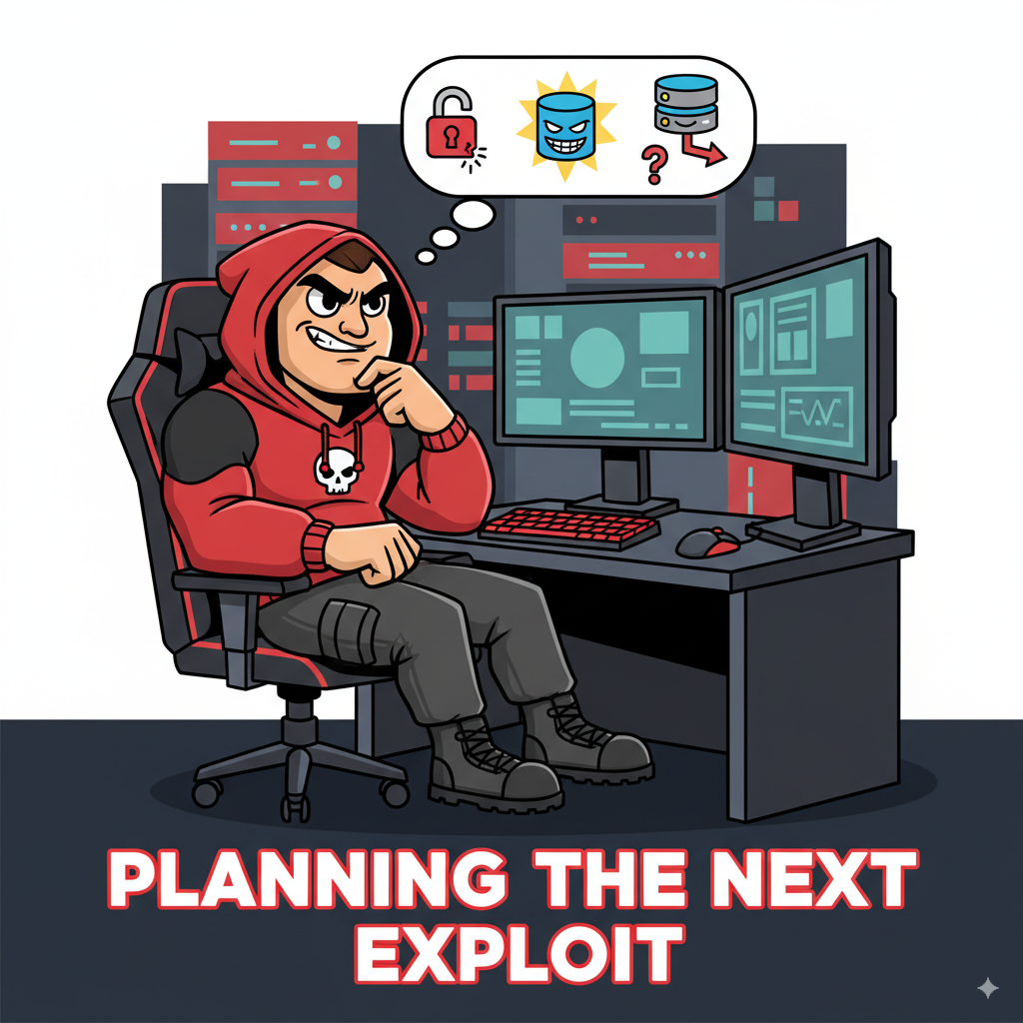
Welcome
Designed to walk through the mental model a good red teamer should have
Coincidentally the same mindset of a purple teamer! ☺
Tradecraft == understanding how tooling works
Initial access is just the beginning.
Attackers move from low-value targets (workstations) to high-value assets (Domain Controllers, file servers).
This is the critical phase where intrusions become breaches, leading to ransomware, data theft, and domain dominance.

Slide 3

Workshop Goals
Understand how attackers move laterally in an AD environment.
Execute common lateral movement techniques using the Empire C2 framework.
Detect the forensic breadcrumbs these attacks leave behind using Sysmon and the Elastic Stack.
Connect the dots from attack action to detection logic.

Slide 4

To the firing range!
To attend this workshop, you will need the following:
An Ubuntu VM
An AWS account (with a credit card linked to it)
Cost of the workshop = 2~5 bucks if you tear it down afterwards, (potentially) free if you still have free credits.

Slide 5

The “range”
Minimalistic by design
1 workstation connected to the sandbox domain
1 sandbox.pwnzone DC
1 treasure island DC (optional)
1 pwnzone DC (optional)
1 bastion host to VPN
1 SOC stack (Elastic)
For this workshop, we are only using the bold hosts, the others are there if you want to experiment domain attacks! Part of a previous (and perhaps future? workshop)

Slide 6
Lab 1: Spinning up
Lab
Every end must have a beginning…
Notes:
This area is intentionally left blank.

Slide 7

The “weapon”
Empire 6 C2
Actively maintained by BCSecurity
Open source (useful to understand the tooling under the hood!)
PowerShell support (ideal for detections for entry level workshops like this one)
GUI
Popular

Slide 8
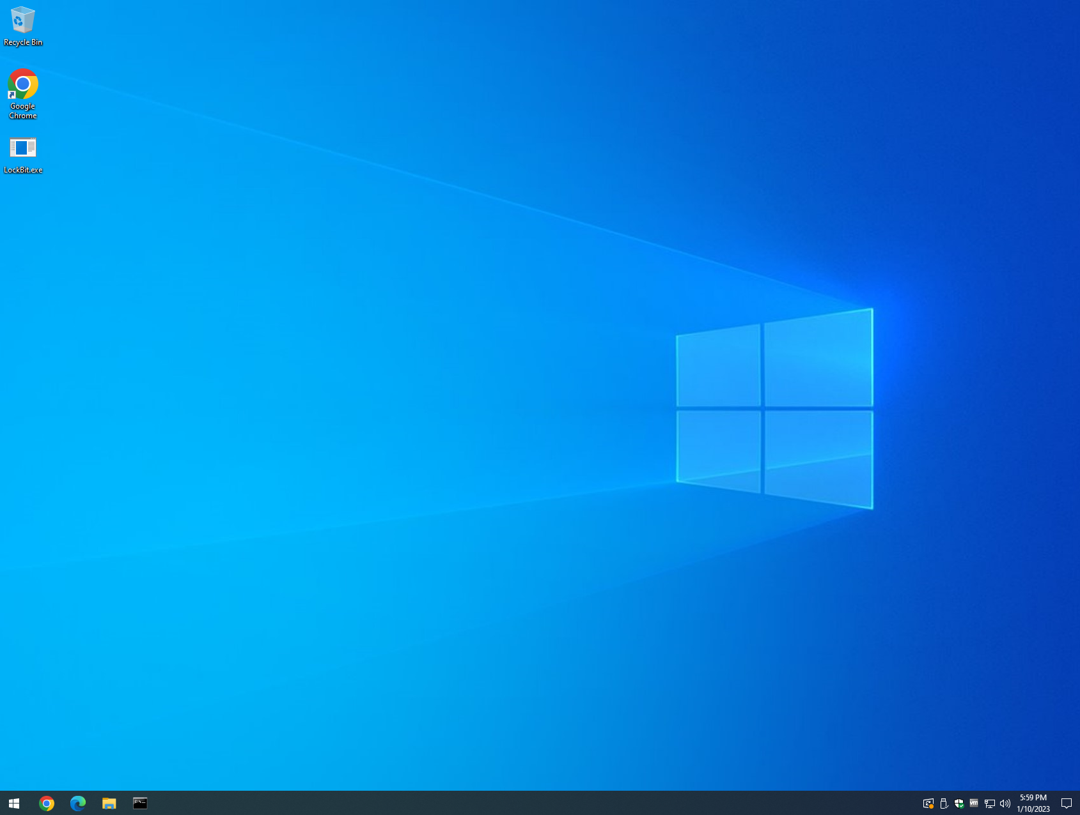
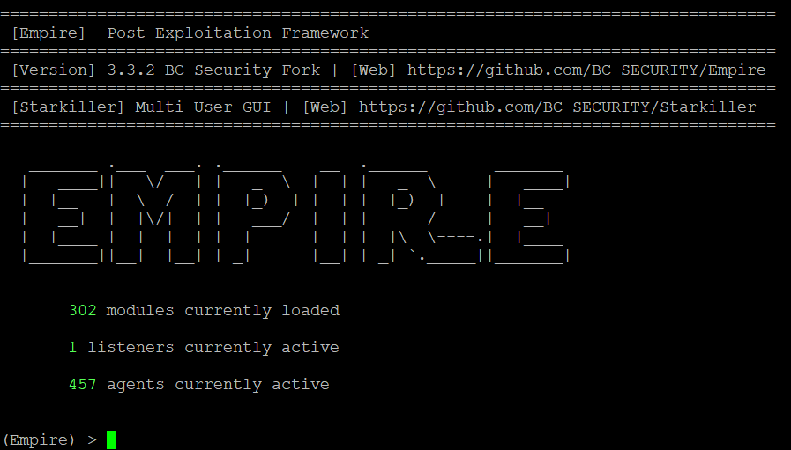
Command and Control
"Command and Control consists of techniques that adversaries may use to communicate with systems under their control within a victim network." - MITRE ATT&CK®
Target
C2 Server
Notes:
This module introduces some of the concepts around command and control. We want to gain and maintain control in the target environment.
Reference:
https://attack.mitre.org/tactics/TA0011/

Slide 9
Listeners
A command and control (C2) server is an attacker-controlled system that is used to communicate with implants
C2 servers "listen," serve tasks, and retrieve the results from the registered implants
A variety of methods to establish network communications or "channels"
C3, or custom command and control, is used to identify bespoke implementations with the intention of avoiding detection of widely distributed tools
Notes:
A command and control (C2) server is an attacker-controlled system that is used to communicate with implants. These servers act as a command center by serving tasks and retrieving the results for the various implants deployed throughout the target space. Modern C2 servers use asynchronous communications in order to keep a lower network footprint and avoid detection.
There are a variety of C3, or custom command and control, frameworks and within each, a variety of methods to establish network communication or channels. We will discuss a few of those methods and focus on the more popular ones.
Reference:
https://attack.mitre.org/tactics/TA0011/

Slide 10
Communication Channels
The most popular C2 channels are:
HTTP/S (network egress)
DNS (network egress)
TCP (peer-to-peer)
SMB (peer-to-peer)
Some more esoteric examples are:
Gmail: https://github.com/byt3bl33d3r/gcat
Google Drive: https://github.com/lukebaggett/google_socks
Slack: https://github.com/Coalfire-Research/Slackor
Twitter: https://github.com/PaulSec/twittor
DNS-over-HTTP: https://github.com/sensepost/godoh
Notes:
Red teams may use a variety of methods to establish and maintain C2 communications. We will discuss the popular channels in further detail, but there are several creative techniques that are worth mentioning:
gcat: Developed by Marcello Salvati (@byt3bl33d3r), gcat is a Python-based backdoor that uses Gmail as a C2 server.
google_socks: Developed by Luke Baggett, google_socks is a script that allows two sockets to communicate while relaying data through Google Drive.
Slackor: Developed by Coalfire, Slackor is a Golang implant that uses Slack as a command and control channel.
Twittor: Developed by @PaulWebSec, Twittor is a Python backdoor that uses Twitter direct messages as a command and control server.
godoh: Developed by SensePost Command and Control framework, godoh is written in Golang and uses DNS-over-HTTPS as a transport medium.
References:
https://github.com/byt3bl33d3r/gcat
https://github.com/lukebaggett/google_socks
https://github.com/Coalfire-Research/Slackor
https://github.com/PaulSec/twittor
https://github.com/sensepost/godoh

Slide 11
C2 Client
A listener needs a client to connect to it for command and control
Depending on the framework/tool, they may be called stagers, payloads, implants, agents, and/or grunts.
This is the code that will run on the target system and communicate to the listener over the respective channel.
Many red team tools will generate the client in a variety of different formats.
Notes:
A listener needs a client to connect to it for command and control. Depending on the framework/tool, they may be called stagers, payloads, implants, agents, and/or grunts. This is the code that will run on the target system and communicate to the listener over the respective channel. Many red team tools will generate the client in a variety of different formats.

Slide 12
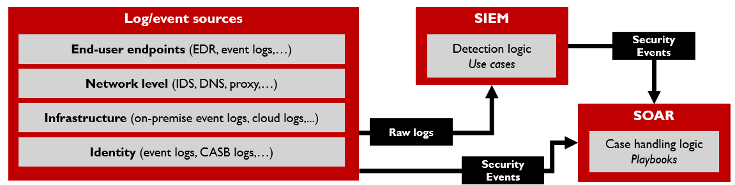
The “Shield”
Blue teams are there to catch the bad guys
Unfortunately, that also means catching pentesters and more importantly red teamers
How do blue teams catch bad stuff in their environments though?

Slide 13
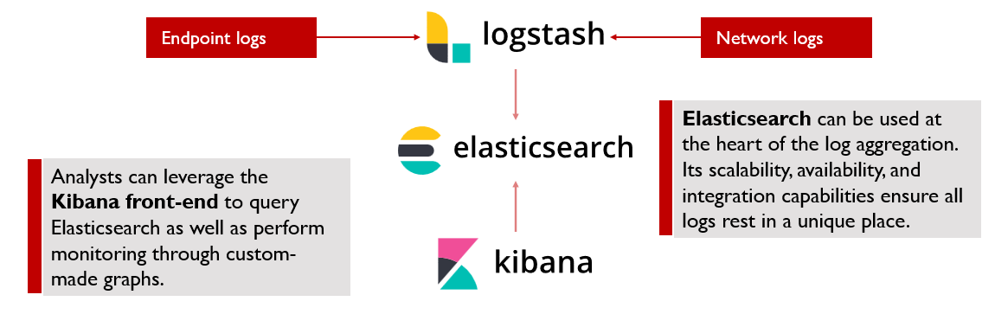
The “Shield”
Various detection platforms available:
Splunk
Elastic
Sentinel

Slide 14
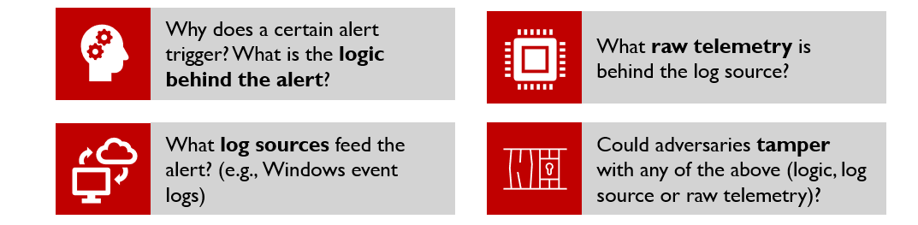
The “Shield”
Mature organizations typically go a step beyond just using “built-in” alerts or detections and have dedicated detection engineering teams. In order to stay abreast of new techniques being leveraged by adversaries, defenders should understand:

Slide 15
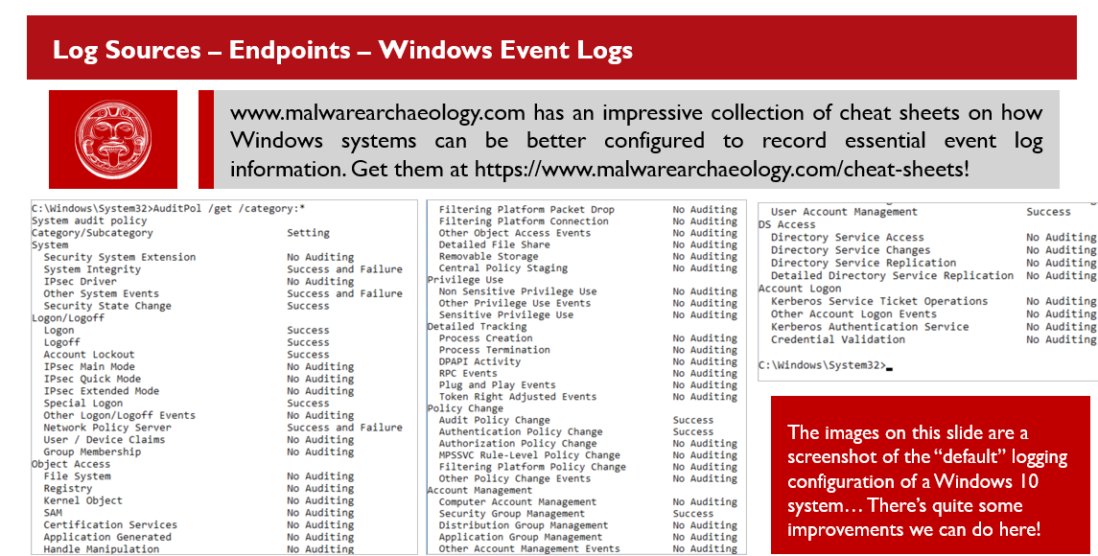
The “Shield”
Log sources are important, mature organizations mix log sources including, but not limited to:
Windows Security Event logs
ETW consumers such as Aurora/Sysmon/…
EDRs
Network level pcaps
….

Slide 16
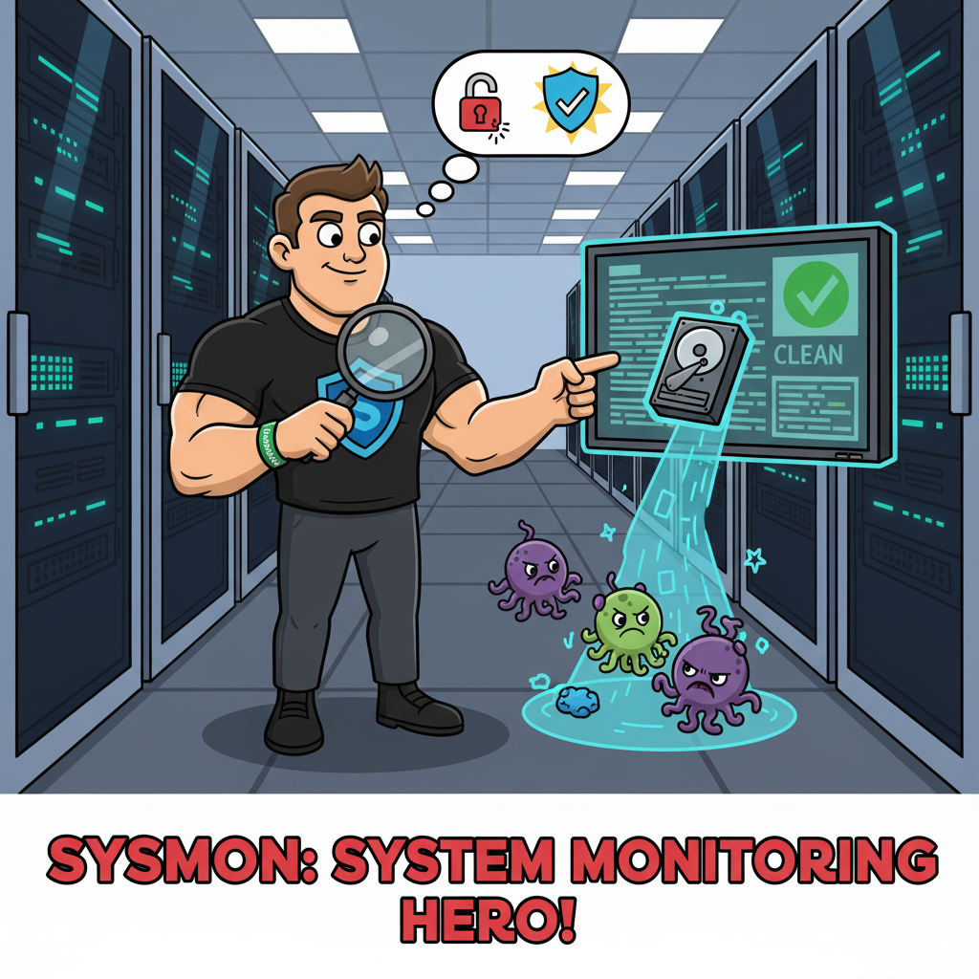
The “Shield”
Sysmon is short for System Monitoring
Sysmon installs a Windows service and a device driver
These components monitor activity on a system:
Creation and termination of processes
Loading of executable images
Network connection establishing
…
Sysmon provides unrivaled visibility on Windows endpoints!

Slide 17
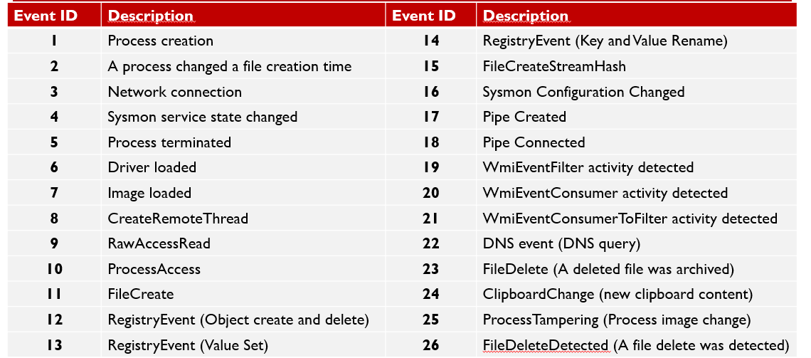
The “Shield”

Slide 18
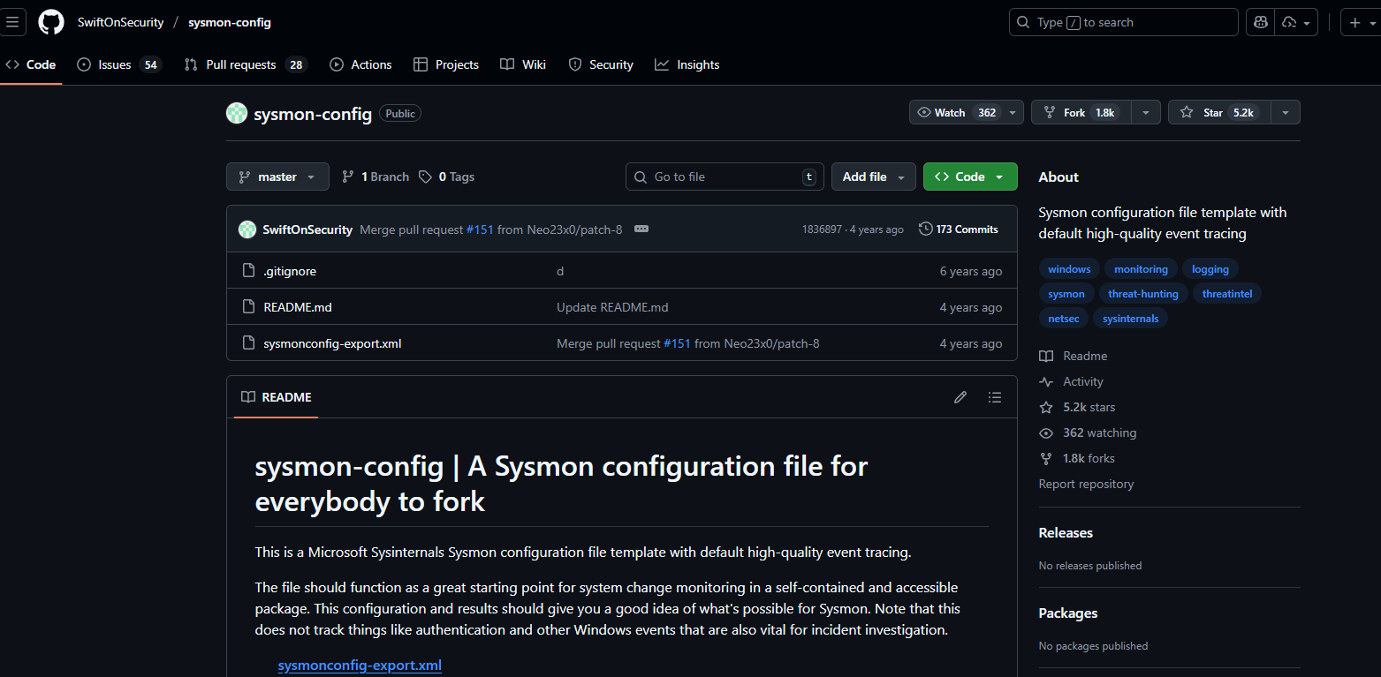
The “Shield”

Slide 19
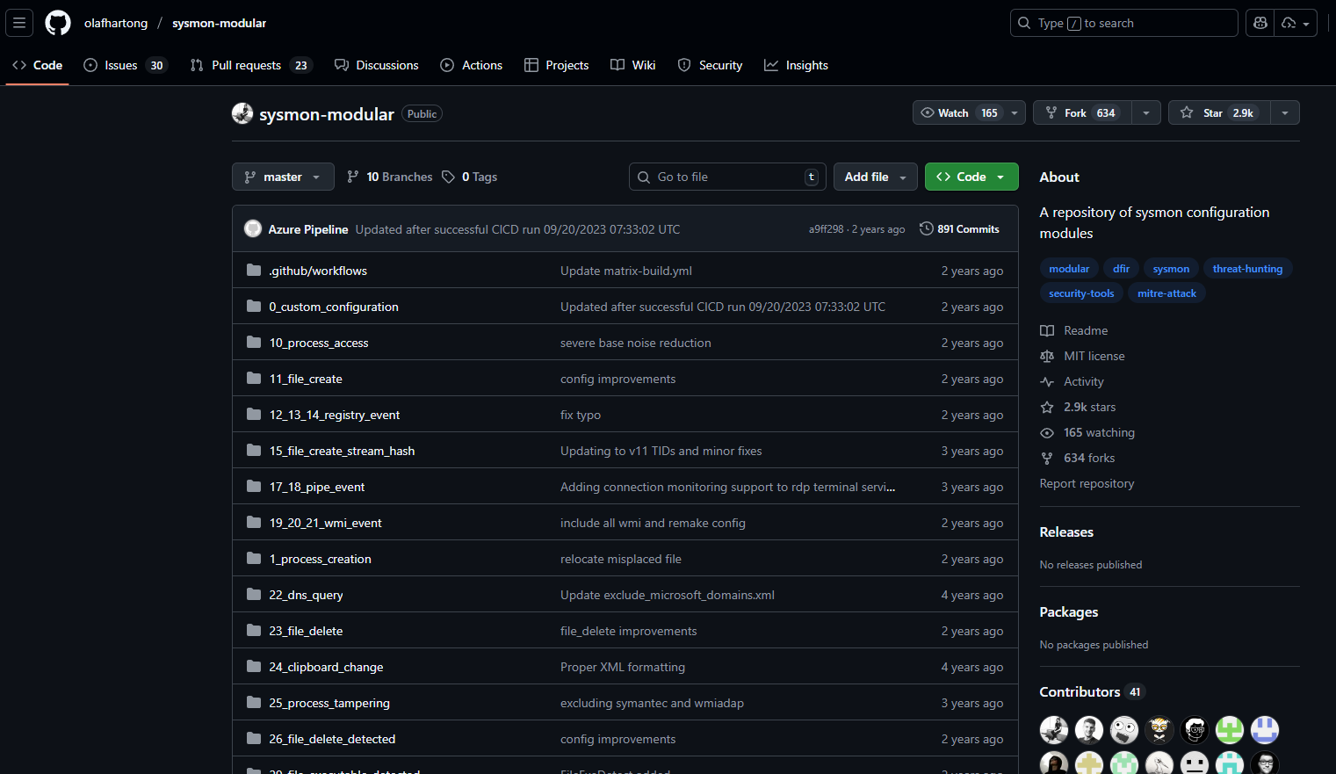
The “Shield”

Slide 20
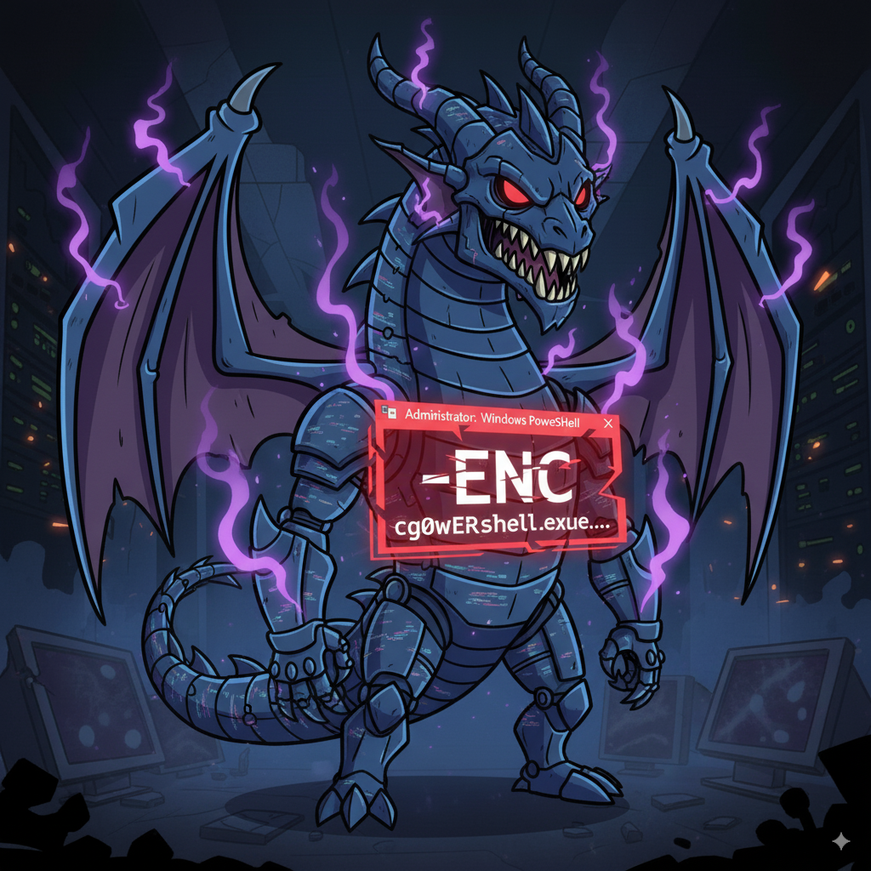
Getting in the purple zone
- An attacker needs to deliver a payload to a victim in some way:
Phishing
Exploitation
Hardware addition
- Most of the time, the payload is self contained, and does not require additional installations (Living Off the Land)
- PowerShell Tradecraft has been around for a very long time and has always been a crowd favorite.
- How can we detect this?

Slide 21
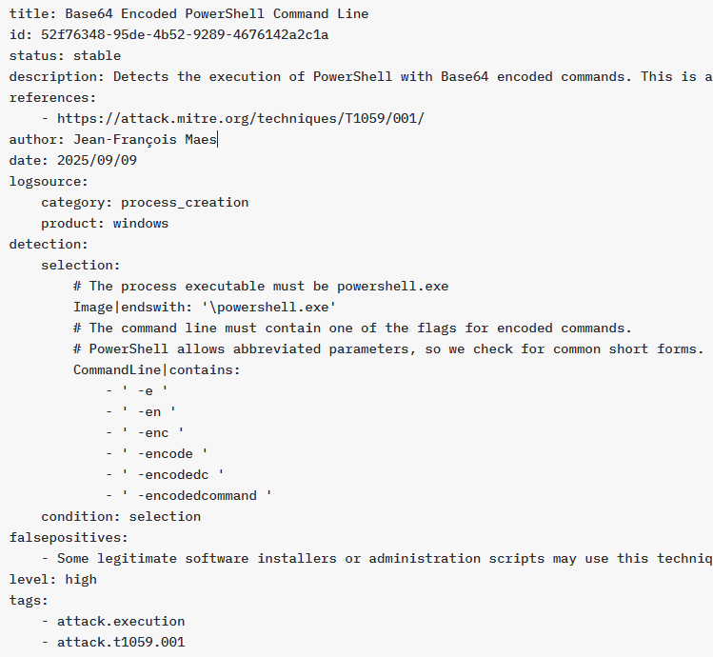
The “Shield”
Blue teams need to speak a common language. Every SIEM is different in terms of query syntax.
We can use Sigma project by Florian Roth that tries to provide a generic, vendor-neutral, rule format that can be used to describe suspicious or malicious behavior.
As part of the project, several "converters" have been written that allow you to convert the SIGMA rules to certain technologies. Supported technologies include (but are not limited to):
Splunk.
Elastic.
ElastAlert.
Windows Defender ATP.
ArcSight.

Slide 22
Lab 2: Empire Setup and Initial Agent
Lab
Help me Obi Wan Kenobi you're my only hope
Notes:
This area is intentionally left blank.

Slide 23

I like to move it move it
In an adversarial kill chain, we very often observe a few common things:
Privilege Escalation (already covered in previous workshop)
Credential Dumping
Lateral Movement
Lateral movement can manifest in a variety of ways:
Windows Remoting
RDP
WMI
SMB
DCOM
COM/DLL Hijacking / Sideloading
….
Understanding how this works and how this is detected is a core red team/purple team skill.
Notes:
Windows Remoting, also known as WinRM, is Microsoft's implementation of the WS-Management protocol. This is done through the usage of COM objects and can thus be utilized in scripting languages that support COM interoperability.
This can open up interesting attack avenues through scripting engines.
However, the most popular and well-known usage of Windows remoting is the PowerShell commandlets "Enter-PSSession" or "Invoke-Command."
References:
https://docs.microsoft.com/en-us/Windows/win32/winrm/portal
https://docs.microsoft.com/en-us/Windows/win32/winrm/scripting-in-Windows-remote-management

Slide 24

Alternate credentials – The how?
To laterally move, adversaries typically need alternate credentials
There are several ways to get those:
Credential Dumping
Token Manipulation
Finding them in clear text on websites, fileshares, …
Notes:
Cobalt Strike has a built-in jump task that facilitates lateral movement. One of the supported techniques is Windows remoting.
As expected, we received a new call-back, and it is of high integrity.
Empire has the built-in "PowerShell/lateral_movement/invoke_psremoting" task available to perform this lateral movement technique.

Slide 25
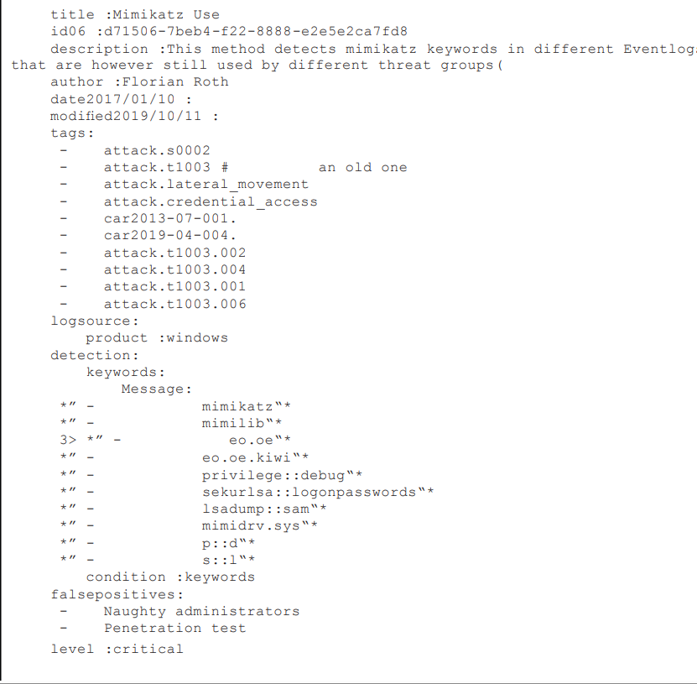
Alternate credentials – Credential Dumping
Several tools to dump creds, most popular tool being Mimikatz. Typically requires OpenProcess API calls + WriteDumpMiniDump API calls
We could hunt for:
EID 1: Process Create + Command line Arguments
EID 11: Mimikatz dropped to disk, dump file dropped to disk
EID 10: Access to LSASS
Notes:
Cobalt Strike has a built-in jump task that facilitates lateral movement. One of the supported techniques is Windows remoting.
As expected, we received a new call-back, and it is of high integrity.
Empire has the built-in "PowerShell/lateral_movement/invoke_psremoting" task available to perform this lateral movement technique.

Slide 26
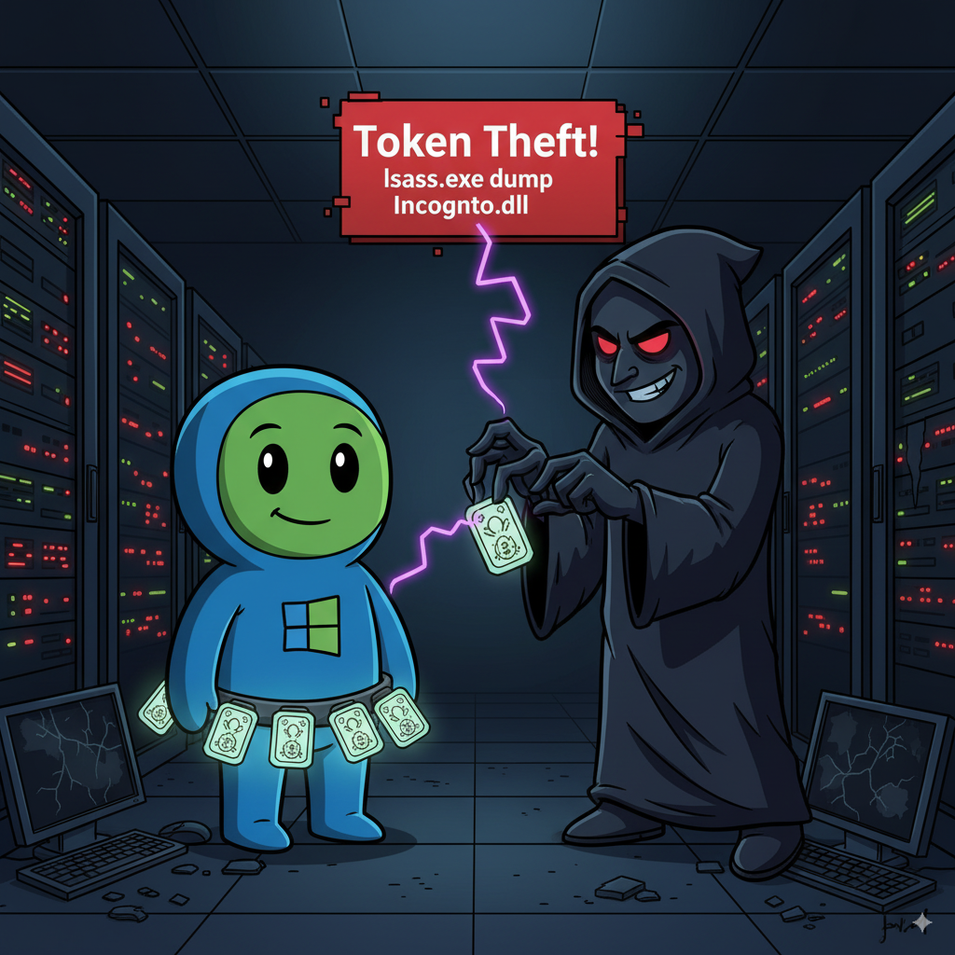
Alternate credentials – Token Creation/Duplication
Access Token manipulation is preferred in red teaming over LSASS dumping because it doesn’t touch LSASS!
Stealthier (kind of)
Uses Either LogonUser API Call or DuplicateToken(ex) API Calls
Creates new logon session (type 9) or opens a handle to a process that does not belong to the same user to duplicate the token…
Notes:
Cobalt Strike has a built-in jump task that facilitates lateral movement. One of the supported techniques is Windows remoting.
As expected, we received a new call-back, and it is of high integrity.
Empire has the built-in "PowerShell/lateral_movement/invoke_psremoting" task available to perform this lateral movement technique.

Slide 27
Windows Remoting
Windows Remoting, also known as WinRM, is Microsoft's implementation of the WS-Management protocol.
VB
C#
Python
PowerShell
Enter-PSSession
Invoke-Command
Notes:
Windows Remoting, also known as WinRM, is Microsoft's implementation of the WS-Management protocol. This is done through the usage of COM objects and can thus be utilized in scripting languages that support COM interoperability.
This can open up interesting attack avenues through scripting engines.
However, the most popular and well-known usage of Windows remoting is the PowerShell commandlets "Enter-PSSession" or "Invoke-Command."
References:
https://docs.microsoft.com/en-us/Windows/win32/winrm/portal
https://docs.microsoft.com/en-us/Windows/win32/winrm/scripting-in-Windows-remote-management

Slide 28
Windows Remoting: Caveats
Feature that is not enabled by default on workstations.
On servers starting Windows server 2012 this feature is present and active by default.
Secured by DACL
Admins
Remote management users
Free UAC bypass
Notes:
The downside of Windows remoting is that it is not enabled by default on workstations.
However, on servers starting Windows Server 2012, this feature is present and active by default. The default security descriptor on WinRM allows only members of the "Administrators" group and the "Remote management users" group to issue remote commands.
If you have administrative privileges on the remote machine, your commands get executed in high integrity (free UAC bypass!)
References:
https://docs.microsoft.com/en-us/Windows/win32/winrm/portal
https://docs.microsoft.com/en-us/Windows/win32/winrm/installation-and-configuration-for-Windows-remote-management
https://docs.microsoft.com/en-us/Windows/win32/winrm/installation-and-configuration-for-Windows-remote-management#rootsddl

Slide 29
Enter-PSSession
PS C:\Users\Administrator> Enter-PSSession -ComputerName FS01.asgard.corp -Credential asgard\Odin
[FS01.asgard.corp]: PS C:\Users\odin\Documents> whoami /priv
<snip>
SeImpersonatePrivilege Impersonate a client after authentication Enabled
SeCreateGlobalPrivilege Create global objects Enabled
SeIncreaseWorkingSetPrivilege Increase a process working set Enabled
SeTimeZonePrivilege Change the time zone Enabled
SeCreateSymbolicLinkPrivilege Create symbolic links Enabled
SeDelegateSessionUserImpersonatePrivilege Obtain an impersonation token for another user Enabled
Notes:
Another cool feature about WinRM using PowerShell is that the commandlets accept the Credential parameter.
This allows you to use alternative credentials without the need to create new tokens or any other user impersonation techniques that we have already covered.
Enter-PSSession -ComputerName FS01.asgard.corp -Credential asgard\Odin

Slide 30
Windows Remoting: How it works
When you run Invoke-Command -ComputerName <target>, the following happens:
Authentication: Your source machine authenticates to the target machine over the network.
Connection: It connects to the WinRM service on the target, which listens on TCP ports 5985 (HTTP) or 5986 (HTTPS).
Session Creation: The WinRM service on the target creates a new PowerShell session for you.
Process Spawning: To host this new session, the WinRM service spawns a new process on the target machine. This is typically a wsmprovhost.exe (Windows Services Management Provider Host) process.
Execution: The ScriptBlock you provided (your stager) is then executed within the context of this wsmprovhost.exe process.
This sequence creates a rich set of logs that we can hunt for.
Notes:
Cobalt Strike has a built-in jump task that facilitates lateral movement. One of the supported techniques is Windows remoting.
As expected, we received a new call-back, and it is of high integrity.
Empire has the built-in "PowerShell/lateral_movement/invoke_psremoting" task available to perform this lateral movement technique.

Slide 31

PsExec
PsExec is Microsoft-backed and carries Microsoft's digital signature.
PsExec works as follows:
Establishes an SMB connection (EID 3 - sysmon)
Copies the service executable to the target (EID 11 - sysmon)
Starts the service (PSEXESVC) (EID 6005)
Creates a named pipe (\\.\pipe\psexesvc) (EID 17 - sysmon)
Notes:
PsExec is an awesome tool that can be used to execute commands on remote computers. It is particularly interesting for attackers as it is part of the sysinternals suite.
This means the tool is Microsoft-backed and carries Microsoft's digital signature. PsExec works as follows:
Establishes an SMB connection
Copies the service executable to the target
Starts the service (PSEXESVC)
Creates a named pipe (\\.\pipe\psexesvc)

Slide 32

SYSTEM Level Privileges for the Win
Because PsExec creates a new service, it is possible to elevate privileges all the way to SYSTEM.
The downside is, PsExec is very noisy due to the way it functions.
Every single step of the PsExec execution flow generates new logs.
Notes:
Because PsExec creates a new service, it is possible to elevate privileges all the way to SYSTEM.
The downside is that PsExec is very noisy due to the way it functions.
Every single step of the PsExec execution flow generates new logs. It is thus not really OpSec-safe unless PsExec gets used in the environment you are operating in on a regular basis.
References:
https://redcanary.com/blog/threat-hunting-psexec-lateral-movement/
https://www.praetorian.com/blog/threat-hunting-how-to-detect-psexec/
Image source: https://www.flaticon.com/

Slide 33

Abusing Services for Lateral Movement
Requires local admin privileges on the remote host
Not OpSec safe
It is, however, a nice way to get a SYSTEM level implant running
C:\> Sc \\remotecomputer create legitservice binpath= C:\TotallyLegitSvc.exe start= auto
Notes:
The Service Control Manager is yet another way to execute lateral movement.
This functionality uses RPC for communication between endpoints and requires local admin privileges on the remote host.
This is not OpSec safe, as service creation is not something that happens all that often, especially not from a remote resource. It is, however, a nice way to get a SYSTEM-level implant running.
A "more" albeit still not great OpSec safe way of performing this kind of lateral movement is to modify an already existing service's "binpath" temporarily, execute your payload, and, if possible, revert the service to the original binpath.
Tip: A service executable has special requirements in order to keep running. You can start a service with a nonservice executable, but it will crash after a few seconds. If you want to use a non-service executable, opt for a process injector, as your binary will die after a few seconds.
C:\> Sc \\remotecomputer create legitservice binpath= C:\TotallyLegitSvc.exe start= auto
References:
https://docs.microsoft.com/en-GB/Windows-server/administration/Windows-commands/sc-create
Image source: https://www.flaticon.com/

Slide 34
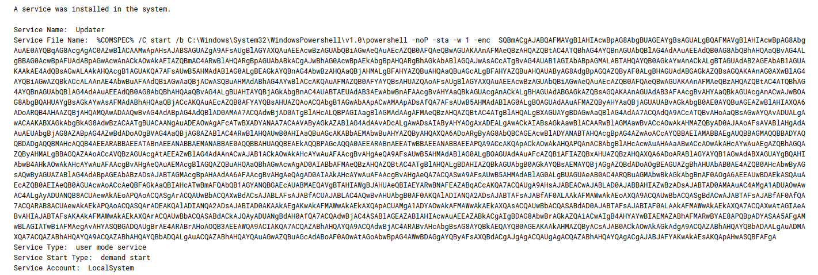
Abusing Services for Lateral Movement
“PSExec” like functionality is bundled by a lot of tools:
All of them work very similarly as what we just described.
Detection wise, trivial through native windows event log 7045 (Service Creation)
Notes:
The Service Control Manager is yet another way to execute lateral movement.
This functionality uses RPC for communication between endpoints and requires local admin privileges on the remote host.
This is not OpSec safe, as service creation is not something that happens all that often, especially not from a remote resource. It is, however, a nice way to get a SYSTEM-level implant running.
A "more" albeit still not great OpSec safe way of performing this kind of lateral movement is to modify an already existing service's "binpath" temporarily, execute your payload, and, if possible, revert the service to the original binpath.
Tip: A service executable has special requirements in order to keep running. You can start a service with a nonservice executable, but it will crash after a few seconds. If you want to use a non-service executable, opt for a process injector, as your binary will die after a few seconds.
C:\> Sc \\remotecomputer create legitservice binpath= C:\TotallyLegitSvc.exe start= auto
References:
https://docs.microsoft.com/en-GB/Windows-server/administration/Windows-commands/sc-create
Image source: https://www.flaticon.com/

Slide 35
Lab 3: PTH + Lateral Movement
Lab
Sometimes the hash is all you need…
Notes:
This area is intentionally left blank.

Slide 36
Thank you!
Workshop
Stay Tuned for part 2 …
Jean-Francois Maes (@Jean_Maes_1994)
© 2025 SANS INSTITUTE | All Rights Reserved
1
Notes:
Welcome to Section 4 of SANS Security 565: Red Team Operations and Adversary Emulation. In this section, we will dive deep into Microsoft Active Directory and leverage the environment for discovery, enumeration, and lateral movement. We will spend considerable time understanding authentication in Active Directory and how we will leverage attacks to hunt for privileges that allow the red team to impersonate network users and traverse the network.

